Slide 1
Text Classification using Graph Neural Networks
Güneykan Özgül
Berk Sudan
Onur Kılıçoğlu
Inzva AI Projects #4 - Showcase - 30.05.2020

Slide 2
Our Team
Güneykan Özgül, Boston Univ. Physics Graduate Student,
R&D Engineer at Pointr: Deep Location Company ozgul@bu.edu guneykan.ozgul@pointrlabs.com
Berk Sudan, YTU Computer Engineering Alumni, Big Data Engineer @TÜBİTAK, berk.sudan.96@gmail.com
Onur Kılıçoğlu, BOUN Computer Engineering Student, onur.kilicoglu@boun.edu.tr

Slide 3
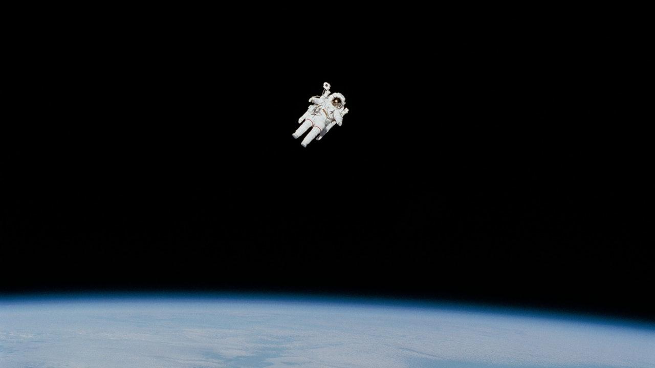
1.
INTRODUCTION
Text Classification & Representation

Slide 4
Text Classification
Text classification, a fundamental problem in NLP
Some Text Classification Applications:
  Document Organization
  News Filtering
  Spam Detection
  Opinion Mining

Slide 5
Text Representation
Text representation, an essential intermediate step for classification
Traditional methods use hand-crafted features such as sparse lexical features
  Bag-of-Words
  N-grams

Slide 6
Deep Learning in Text Representation
Deep learning models widely used to learn text representations
Examples
  RNNs such as LSTM (Hochreiter and Schmidhuber 1997)
  CNNs (Kim 2014)

Slide 7
CNN & RNN in Text Representation
Pros
  Can capture semantic and syntactic information in local consecutive word sequences well
Cons
  May ignore global word co-occurrence in a corpus which carries non-consecutive and long-distance semantics (Peng et al. 2018)

Slide 8
Graph NN in Text Representation
Effective at
  Tasks thought to have rich relational structure
Can preserve
  Global structure information of a graph in graph embeddings

Slide 9
2.
Theory
Graph Convolutional Networks & Graph Attentional Layers

Slide 10
Graph Convolutional Layer - Literature Review
Graph Convolutional Networks for Text Classification (Liang Yao, Chengsheng Mao, Yuan Luo, 2019)
  A GCN that works directly on a graphical representation of a document
  Induces embedding vectors of nodes based on properties of their neighborhoods

Slide 11
Conventional CNN
A convolution = mixing operation
Fixed-size kernels
Conventional CNN is popular in
  1-dimensional time-series data (e.g., sound)
  2-dimensional data with spatial locality (e.g., image)
  3-dimensional data with spatial locality (e.g., Magnetic Resonance Imaging data)

Slide 12
Graph Convolutional Layer
Number of neighbours changes, so no fixed-size kernels
No global location, but relative locations
Cannot define with matrices directly

Slide 13
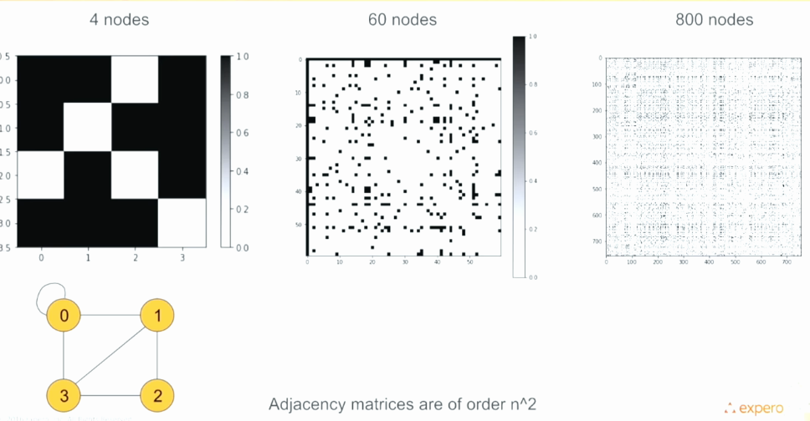
Locality Problem of Graph-CNN
Ref: https://www.experoinc.com/post/node-classification-by-graph-convolutional-network

Slide 14
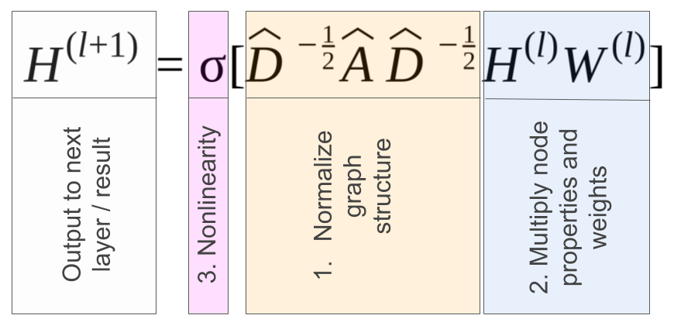
Graph Convolutional Layer - Formula
Ref: https://www.experoinc.com/post/node-classification-by-graph-convolutional-network

Slide 15
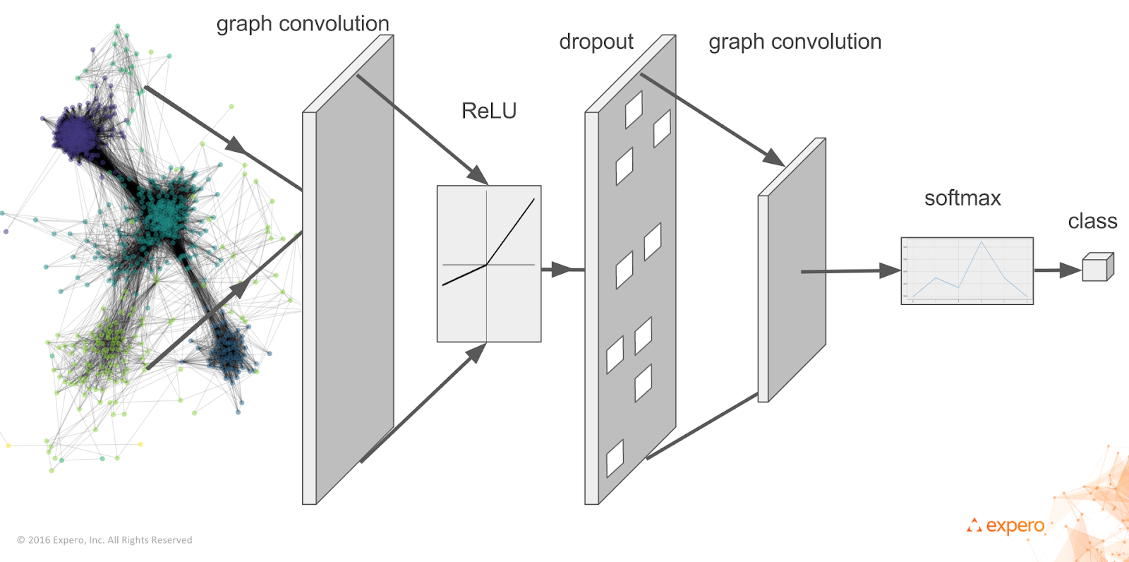
Graph Convolutional Layer - Visually
Ref: https://www.experoinc.com/post/node-classification-by-graph-convolutional-network

Slide 16
Graph Attentional Layer - Literature Review
Graph Attention Networks (Velickovic, 2017)
  A novel highly effective neural network architecture
  Enables specifying different weights to different nodes in a neighbourhood

Slide 17
Graph Attentional Layer - Basic Idea
Can improve the accuracy with an attention mechanism
With attention heads & vectors, update node-features

Slide 18
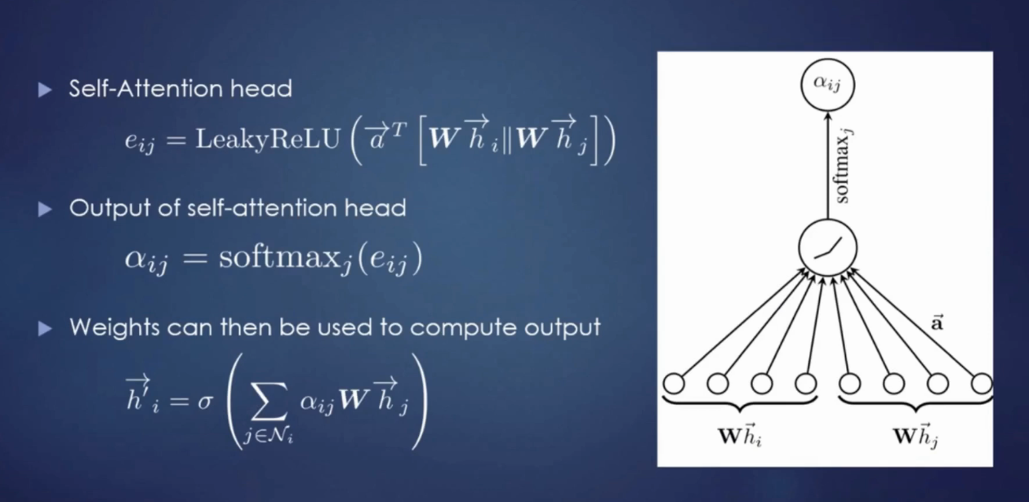
Graph Attentional Layer - Visually
Ref: https://ai.science/e/gat-graph-attention-networks--2019-04-15

Slide 19
3.
Our Methods
Our-GCN & Our-GAT

Slide 20
Our GCN Model
We’ve implemented a GCN model
  to learn word and document embeddings simultaneously
A single large graph from an entire corpus, which contains words and documents as nodes
A 2-layer GCN can allow message passing among nodes that are at maximum two steps away

Slide 21
Our GCN Model - Details
No direct document-document edges in the graph
The two-layer GCN allows the information exchange between pairs of documents
The second layer node (word/doc) embeddings have the same size as the labels set and are fed into a softmax classifier

Slide 22
Our GCN Model - Nodes & Edges
Edge between two word nodes is built using
  Word co-occurrence information (PMI)
Edge between a word node and document node is built using
  Word frequency and word’s document frequency (TF-IDF)

Slide 23
Our GCN Model - Nodes & Edges
Introduction of edges between two documents does not improve performance greatly
Doc-doc edges were built by using hand-crafted metrics (such as cosine similarity) or from GAT output (attention coefficients)
Initializing the features with one-hot representation (featureless) works equally well

Slide 24
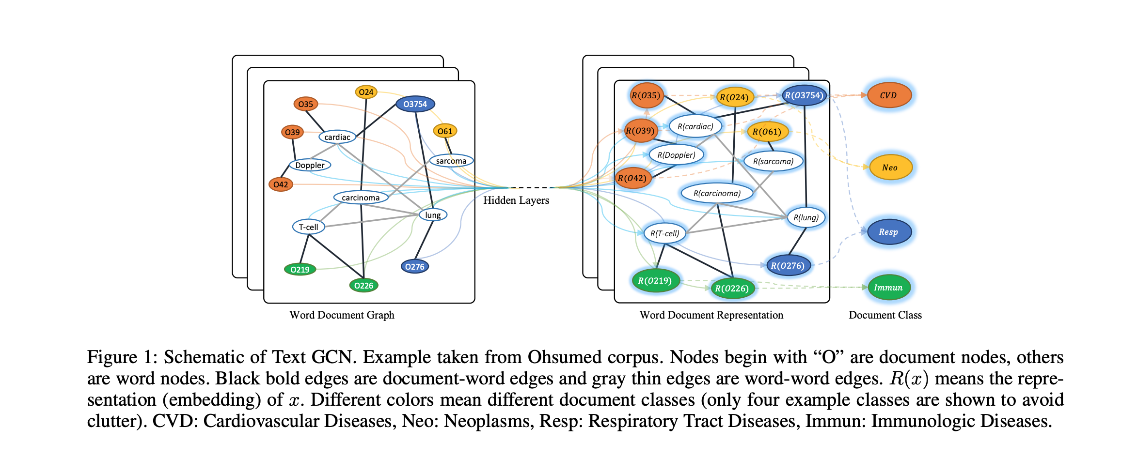
Our GCN Model - Visually

Slide 25
Our GAT
Operate on graph-structured data
Leveraging masked self-attentional layers to address the shortcomings of prior methods based on graph convolutions (or their approximations)

Slide 26
Our GAT - Details
By stacking layers in which nodes are able to attend over their neighborhoods’ features
Enable (implicitly) specifying different weights to different nodes in a neighborhood
  without requiring any costly matrix operation (such as inversion) or depending on knowing the graph structure upfront

Slide 27
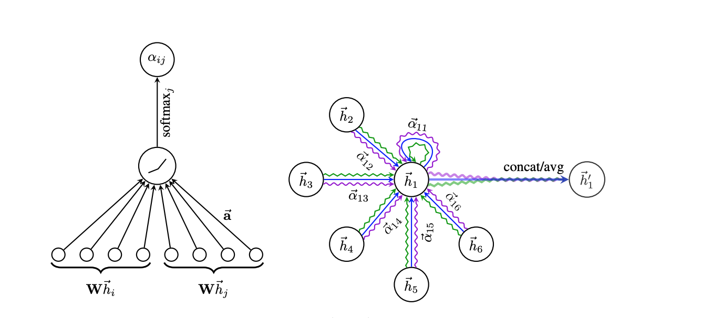
Our GAT - Visually

Slide 28
4.
Evaluation
Data Preparation & Applying GCN/GAT

Slide 29
GCN - Evaluation
Pre-Processing
  Cleaned Data
  Removed Rare & Stop Words
  Shuffled Data (to reduce bias)
Building Graph
  For Node Features: Training-test docs, word features
  For Adjacency Matrix: PMI & TF-IDF scores

Slide 30
GAT - Evaluation
Implemented GAT network to learn attention coefficients to be able to specify different weights for different nodes in neighbourhood
Since we do not have graph data for each dataset, we only have results for cora, citeseer and pubmed data for now.
Currently evaluated results on citation graphs

Slide 31
GCN + GAT
Implemented GAT architecture that works on a graph consisting of words and documents rather than only documents
Will use attention coefficients to learn graph representation on which GCN operates
Currently requires some optimization and modifications to have consistent increase in accuracy

Slide 32
5.
Results
Datasets & Results

Slide 33
Our Datasets
20NG
Newsgroups dataset, 18846 documents, 20 labels. Training-Size: 11314, Test-Size: 7532
Ohsumed
Cardiovascular diseases abstracts dataset, 7400 documents, 23 labels. Training-Size: 3357, Test-Size: 4043
R8
Subset of Reuters 21578 dataset, 7674 documents, 8 labels. Training-Size: 5485, Test-Size: 2189
R52
Subset of Reuters 21578 dataset, 9100 documents, 52 labels. Training-Size: 6532, Test-Size: 2568
MR
Movie review dataset, 10662 documents, 2 labels. Training-Size: 7108, Test-Size: 3554
Cora
Citation dataset, 2708 nodes, 5429 edges, 7 classes. Training-Size: 1707, Validation-Size: 189, Test-Size: 812
Citeseer
Citation dataset, 3327 nodes, 4732 edges, 6 classes. Training-Size: 2097, Validation-Size: 232, Test-Size: 998
Pubmed
Citation dataset, 19717 nodes, 44338 edges, 3 classes. Training-Size: 12422, Validation-Size: 1380, Test-Size: 5915

Slide 34
Evaluation Results for Citation Datasets
 | Cora | Citeseer | Pubmed
GCN (Kipf, Welling) | 81.5 % | 70.3 % | 79.0 %
Text-GCN (Yao, Mao, Luo) | 75.86 % | 73.21 % | 85.87 %
GAT (Velickovic) | 83.0 ± 0.7 % | 72.5 ± 0.7 % | 79.0 ± 0.3 %

Slide 35
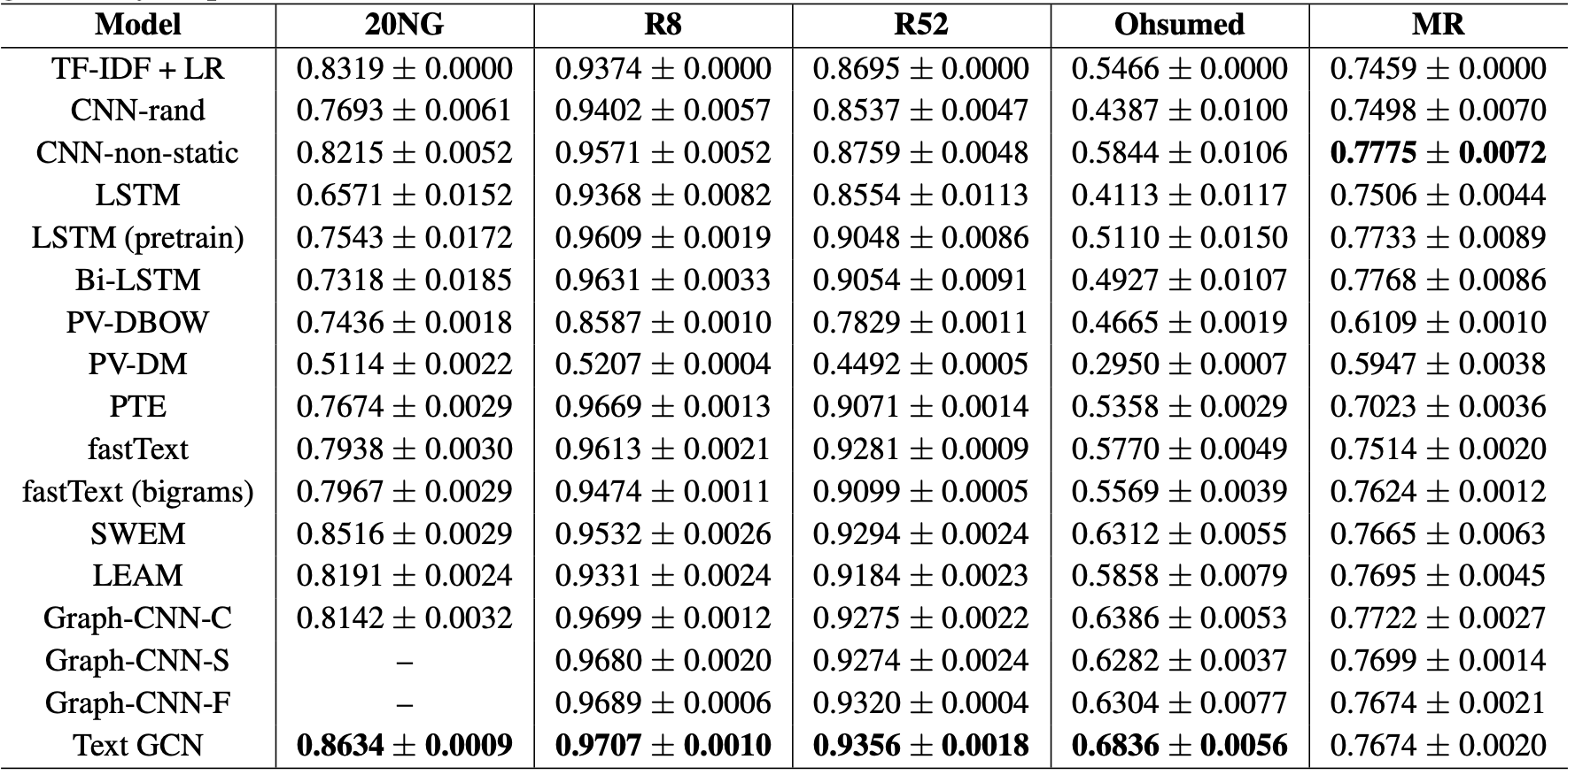
Evaluation Results for Other Datasets

Slide 36
Code is available at
https://github.com/guneykan/gcn_text_categorization
https://github.com/inzva/Text-Classification-Graph-CNNs

Slide 37
References
[Liang Yao, Chengsheng Mao, Yuan Luo, 2018] Graph Convolutional Networks for Text Classification: https://arxiv.org/abs/1809.05679
[Kipf and Welling, 2017] Semi-supervised classification with graph convolutional networks. InICLR.
[Ankit Pal] Multi-label Text Classification using Attention based Graph Neural Network
[Petar Velickovic] Graph Attention Networks

Slide 38
Text Classification using Graph Convolutional Networks
Thank you for listening!
Güneykan Özgül
Berk Sudan
Onur Kılıçoğlu
Inzva AI Projects #4 - Showcase - 30.05.2020

